Slide 1
Drugs On Bugs
a medicine reviewing app
Batch-A7
Mentor: Mr.katakam Venkateswarlu
Roll no’s:
2111CS030057-Ch.Medha Sree
2111CS030050- Ch. Lakshmi Akhil
2111CS030021- G. Chaitra Reddy
2111CS030048- K. Kranthi Verma

Slide 2
Table of contents
01
Abstract
02
Introduction
03
Literature Survey
04
Result and Conclusion
Proposed Methods
05

Slide 3
Abstract
In today’s digital era healthcare is one among the major core areas of the medical domain.
The Internet could be a great resource for this kind of data, however you need to take care to avoid getting harmful information.
The goal of this system is to give information on drugs based on the condition, ratings, and reviews for each health condition of a patient.
This app is used to provide users with the correct medication for their ailments

Slide 4
Introduction
Drug information systems are becoming increasingly popular as they help patients make informed decisions about their health. These systems use various factors such as ratings, reviews, medical conditions, and useful counts suggest drugs to patients .
Based on these factors, drug information systems can provide personalized suggestion to patients based on their medical condition and reviews of the drugs from other patients.

Slide 5
Literature Survey
Knowing about the drugs information is an important task in healthcare where a physician suggests a drug to a patient based on their symptoms.
The literature on peronalised suggestion based on rating, review, UniqueID, and useful count data suggests that these data sources can be used to build effective drug discovery systems.

Slide 6
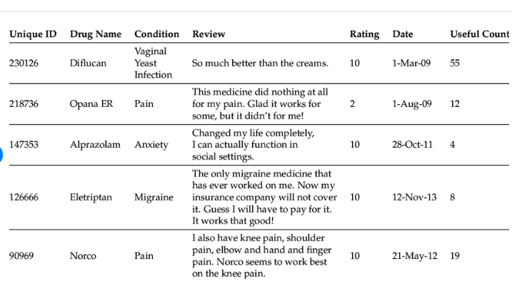
Table 1.1 Sample of drug review data-set used in our code.

Slide 7
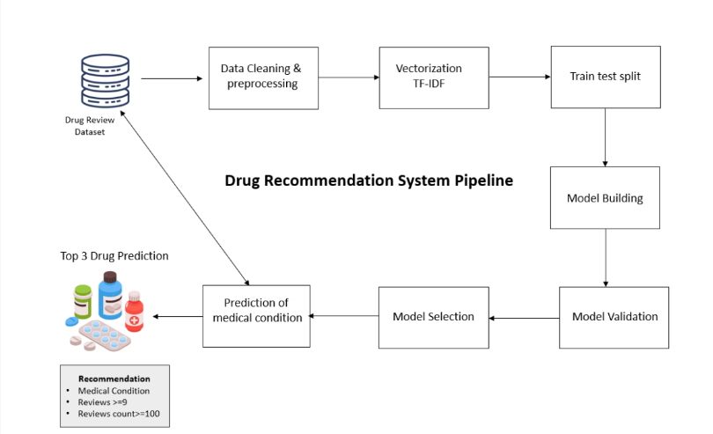

Slide 8
Proposed Methods
There are several methods that can be used to give the information on drugs based on rating, review, and condition. There are some of the methods which are used to give the information they are Rating Aggregation, Personalised Suggestion Engine, Collaborative Filtering,Natural Language Processing(NPL) .
1.Rating Aggregation:
Calculate the average rating based on user reviews for each drug. Develop a rating aggregation algorithm that takes into account factors such as the number of reviews, the usefulness count, and the credibility of reviewers. This can help in identifying the top-rated drugs or providing an overall rating for a specific drug.

Slide 9
2.Personalised Suggestion Engine:
Implement to suggest drugs based on user preferences and feedback. Collaborative Filtering or Content-Based Filtering techniques can be used to identify similar drugs or to suggest drugs with high ratings and positive reviews.

Slide 10
3.Collabarative Filtering:
Implement collaborative filtering algorithms to provide personalized drug recommendations based on user ratings and reviews. This method analyzes the behavior of similar users and suggests drugs that other users with similar preferences found useful.

Slide 11
4.Natural Language Processing(NPL):
Use NLP techniques like topic modeling or named entity recognition to extract meaningful information from drug reviews. This can help in identifying common topics, side effects, or benefits mentioned in the reviews.

Slide 12
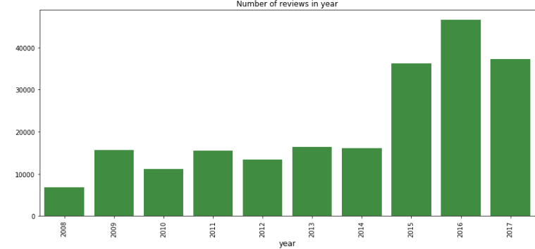
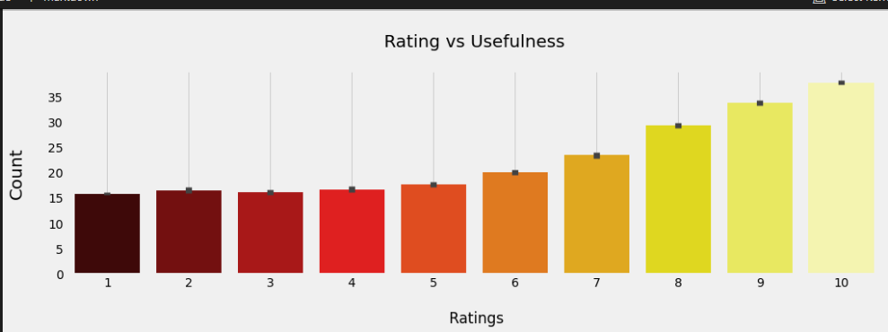

Slide 13
In this project, we will be using the Drug dataset .The dataset consists of 1,61,297 reviews of the users with 7 columns. The columns of the dataset are shared below:
1.uniqueID : An identifier for each Drug.
2.drugName : The name of the drug for which review is made.
3.condition : The name of the medical condition for which the
medicine is used.
4.review : The review made by patients for a particular medicine.
5.rating : Ratings, given by the patients to each medicine on a
scale of 10 where 10 represents the maximum efficacy.
6.date : Date of review entry.
7.usefulCount : The number of users who found the review useful.

Slide 14
Result
In this work, each review was classified as positive or negative, depending on the user’s star rating.
Ratings above five are classified as positive, while negative ratings are from one to five-star ratings.
Structured Medicine Reviews (SMRs) are an evidence-based and comprehensive review of a patient’s medication, taking into consideration all aspects of their health.
Conclusion
A medicine personalised suggestion is similar system that suggests the medicines for a particular disease based on patient reviews.
This system is very essential in this fast growing technological world, which can save lives by helping doctors.

Slide 15
Thank you!

